Slide 1





Digital implementation of
Hodgkin-Huxley neuron model
for neurological diseases studies
T. Levi, F. Khoyratee, S. Saighi, Y. Ikeuchi
University of Bordeaux, IMS Lab., France
IIS, The University of Tokyo, Japan
AROB 2017, January 20th

Slide 2
Content
Context
Digital biomimetic neurons
Project
Conclusion
2

Slide 3
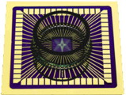
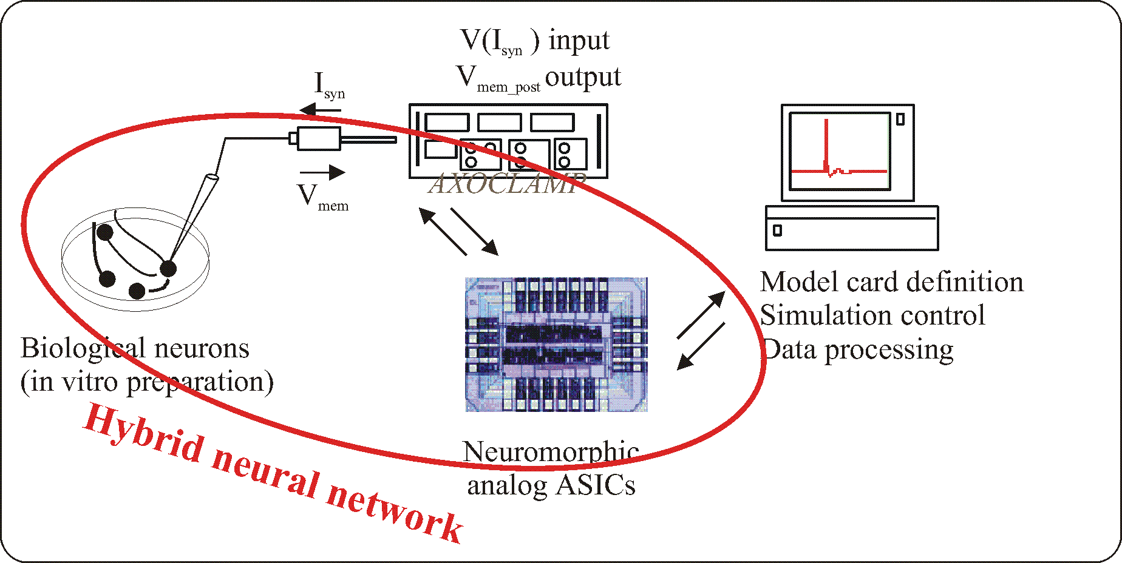
Objective of our research
1 population of biological neurons
↔
1 population of artificial neurons
1 biological neuron ↔1 silicon neuron
Spiking Neural Network
Le Masson, G., Renaud, S., Debay, D., and Bal, T. (2002). Feedback inhibition controls spike transfer in hybrid thalamic circuits. Nature. 417, 854-858.
3

Slide 4
Bioinspired or Biomimetic
A bio-inspired system is inspired by nature for dealing with engineering task (neural network for pattern recognition, data mining, etc.).
A biomimetic system mimics the nature for simulating the living behavior and/or replaces it (rebuilding the living part).
CPG:
Bioinspired: oscillator with constant frequency and duty cycle
Biomimetic: neural network with variability of frequency and duty cycle as we observed in the nature
4

Slide 5
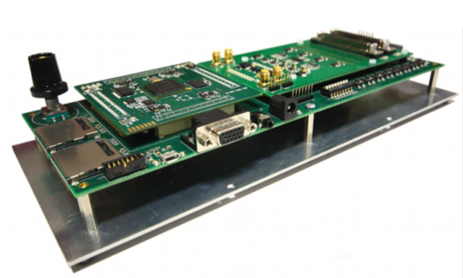
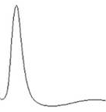

Neuromorphic board
Amplifications/Analog filters
Event Processing
Spiking Neural
Network
(SNN)
Event
Detection
Living Cells
Trigger Generator
Stimulation
Neuromorphic board: Multimed
5
Notes:
Système Multimed réalisé par l’équipe Elibio

Slide 6
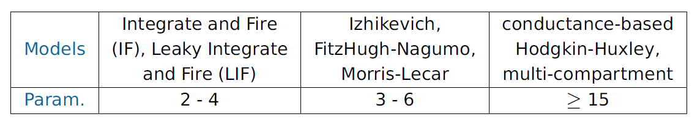
Neuron model
The model for a single neuron must be:
computationally simple
capable of producing rich firing patterns exhibited by real biological neurons
Which model to use for cortical spiking neural networks hardware simulations?
6

Slide 7

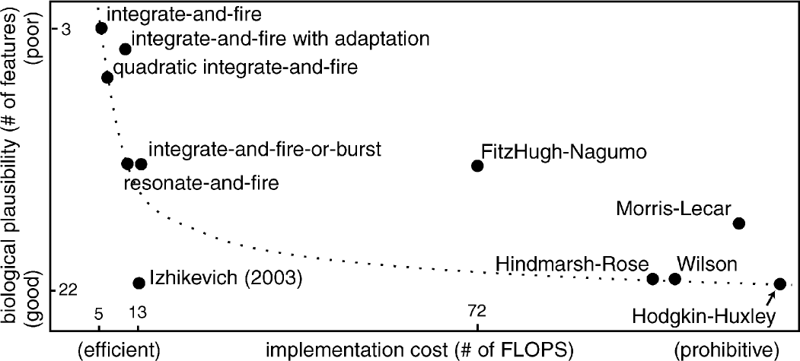
Neuron model
Which model to use for cortical spiking neural networks hardware simulations?
Integrate & Fire
Izhikevich
Hodgkin-Huxley
Source: www.izhikevich.com
7

Slide 8
Content
Context
Digital biomimetic neurons
Project
Conclusion
8

Slide 9
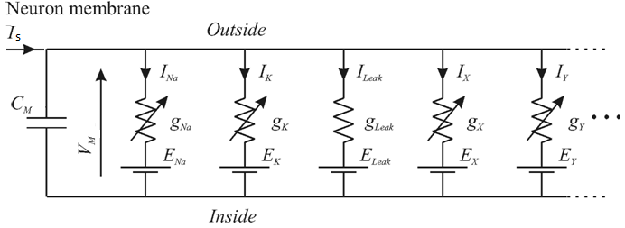
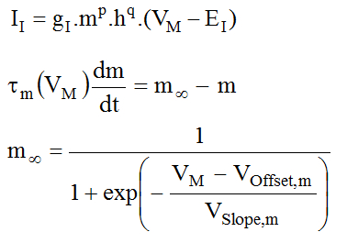
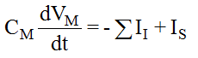
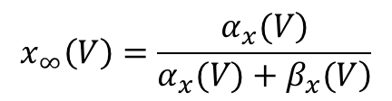
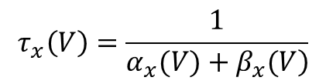
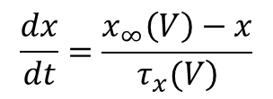
Hodgkin-Huxley Formalism
Conductance-based silicon neurons
$$\frac{dx}{dt}=\frac{x_{∞}\left(V\right)−x}{\left.τ_{x}(V\right)}$$
$$τ_{x}\left(V\right)=\frac{1}{\left.α_{x}(V)+β_{x}(V\right)}$$
$$x_{∞}\left(V\right)=\frac{\left.α_{x}(V\right)}{\left.α_{x}(V)+β_{x}(V\right)}$$
9

Slide 10
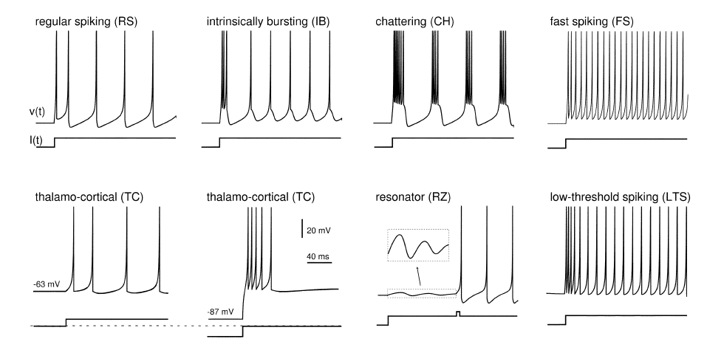
Types of neurons
inhibitors
excitators
10

Slide 11
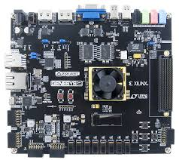
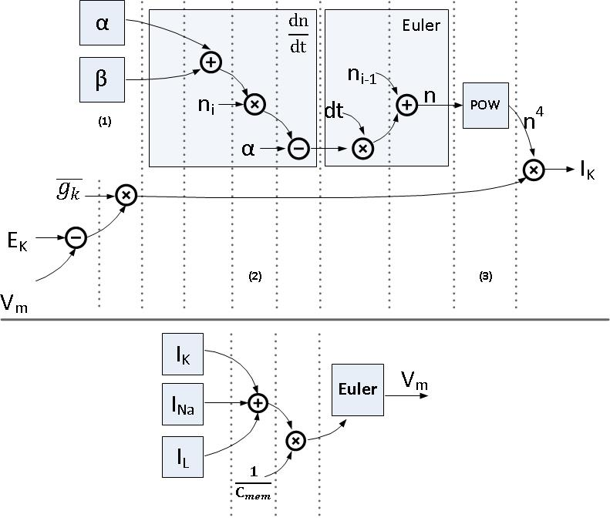
Digital implementation
FPGA board
Real-time
Unsupervised
Biological scale
Pipeline implementation
Few resources (25 H&H neurons)
11

Slide 12
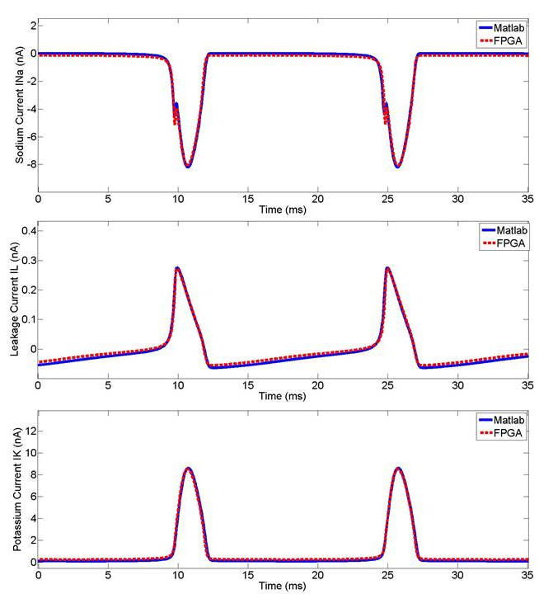
Ionic channel
12

Slide 13
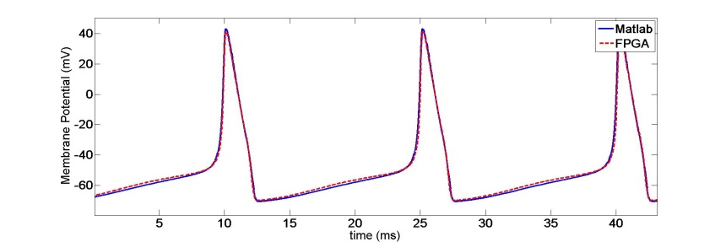
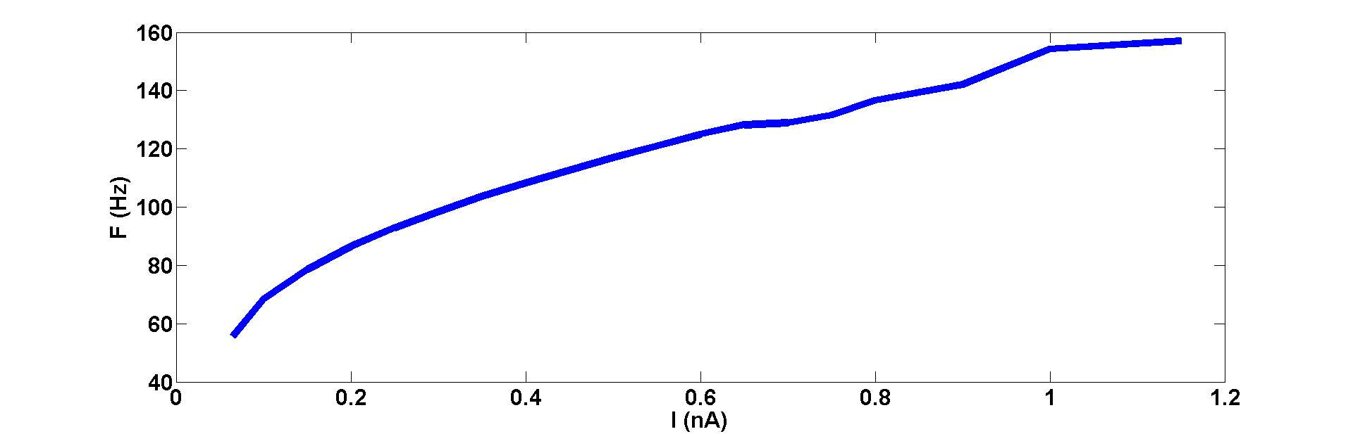
Membrane potential and dynamic
13

Slide 14
Content
Context
Digital biomimetic neurons
Project
Conclusion
14

Slide 15
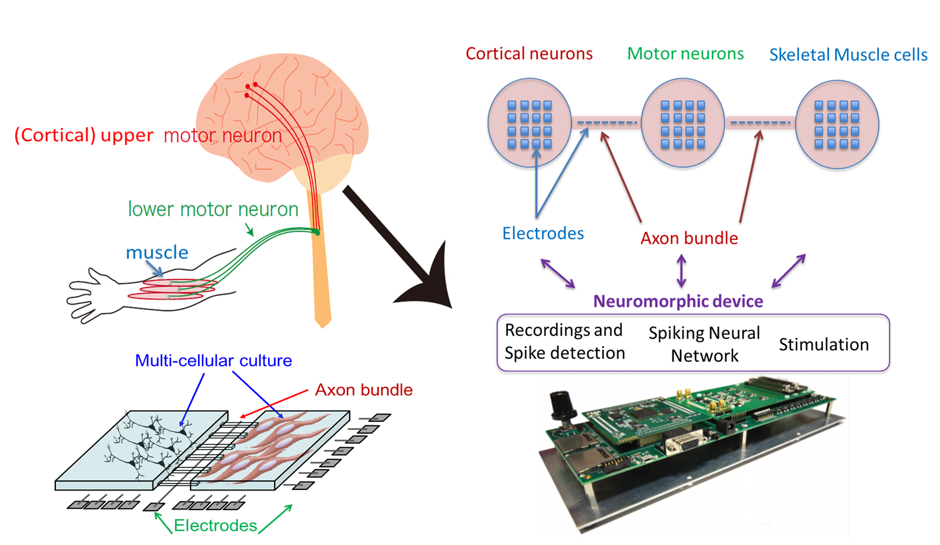
Hybrid platform system
15

Slide 16
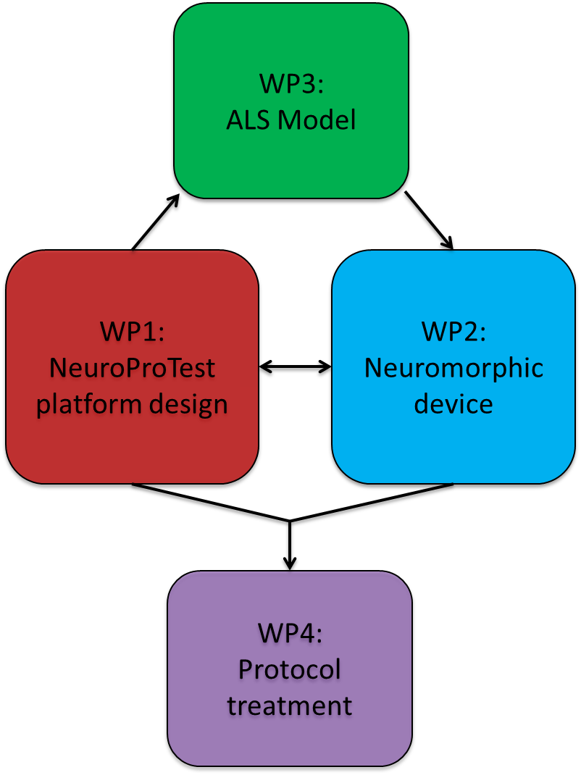
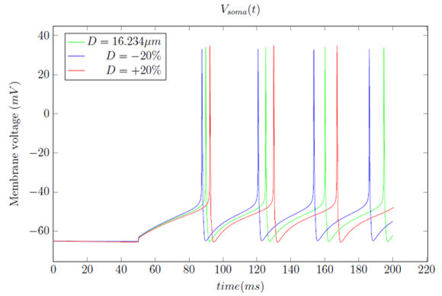
Neurological diseases
ALS, Tuberous Sclerosis diseases
For TSC, following soma diameter, the frequency, and amplitude are changing
16

Slide 17
Conclusion and perspectives
Digital implementation of HH model
Validation with software and biological data
Multi-compartmental architecture
Neural network architecture
Hybrid experiments
Implementation of neuronal disease model
17

Slide 18

Thank you for your attention
Do you have any questions ?

